Slide 1
Crime and Healthy Food Priority Areas: The Case of Baltimore, MD
D. Diego Torres, Ph.D.

Slide 2
Crime in the Big City
Less than an hour drive from the nation's capital of Washington, D.C., Baltimore, Maryland is an urban area beset by a high rate of violent crime.
One of consequences of a high crime rate is that it discourages retail development where it is persistent.
Where it concerns the food security of people living in high crime areas, the lack of development can have lasting impacts on their access to healthy foods, which, in turn, can lead to more crime.

Slide 3
Crime and Access to Healthy Foods
Baltimore's Department of Planning and the Johns Hopkins Center for a Livable Future aims to balance the need for greater access to food security for those in high crime areas or neighborhoods and the need for business' right to economic security.
By identifying what it terms Healthy Food Priority Areas (HFPA), the department can make recommendations on the best location for supermarket development in the city of Baltimore.
Whereas identification of HFPAs have been dependent on the relationship of the median household income to the federal poverty level, the percentage of households with access to a vehicle, and the distance to a supermarket, crime has been a neglected factor.

Slide 4
Healthy Food Priority Areas
Approximately a quarter of Baltimore, Maryland's 600,000 residents live in an HFPA (formerly referred to as 'food deserts’).
Nearly 125,000 Black Baltimoreans (or about 31% of the Black population) live in HPFAs; this compares to a little more than 16,000 Whites (or about 9% of the White population.
Nearly a third of all children in Baltimore, some 38,000 youngsters, do not have access to healthy foods where they live.
The average Healthy Food Availability Index (HFAI), a measure of the degree to which a market basket of staple foods and healthy options of common foods are available, is in the lowest tier.
Indeed, almost 50 percent of Baltimore neighborhoods are classified as Healthy Food Priority Areas.

Slide 5
Properly Identifying Healthy Food Priority Areas
Median income, race, and vehicle ownership, while they may be associated with limited access to healthy foods, are also factors that may be explained by something else.
Ignoring crime, which has negative relationship with income and vehicle ownership, and which is predominant among racial minorities, means that one cannot truly understand why some neighborhoods have high numbers of supermarket and why others have low number of supermarkets.
Proper identification of HFPAs must consider crime.
Once properly identified, suggestions may be made to the city of Baltimore about where to locate supermarkets to achieve food equity.

Slide 6
Research Aim
This project seeks to highlight areas of the city of Baltimore where its Department of Planning and the Johns Hopkins Center for a Livable Future might advocate for future grocery store and supermarket locations to be built or opened.
Primarily a spatial analysis problem, this project considers existing grocery store and supermarket locations in the context of the city's neighborhood crime rates, but looks at high crime areas as locations that could in future could be host to increased development.

Slide 7
Data
For this project I will utilize two primary data sources:
Baltimore Neighborhood Crime Data from https://data.baltimorecity.gov/Crime/Crime-by-Neighborhood/6ayg-3z5z
Baltimore area supermarket data from Foursquare.

Slide 8
Data (cont’d)
Crime data come from calendar year 2018 and include reports of nearly 70,000 violent crimes committed in 230 neighborhoods of Baltimore.
Crimes include aggravated assault, arson, auto theft, burglary, common assault, homicide, larceny, larceny from auto, rape, robbery-carjacking, robbery-commercial, robbery-residence, robbery-street, and shooting.
The data are aggregated to the neighborhood level and a crime rate per 1,000 residents is calculated based on population numbers from the 2010 Census.

Slide 9
Data (cont’d)
To count the number of supermarkets within each Baltimore neighborhood, I use Foursquare to extract venue data for supermarkets only.
I limit the project to supermarkets because they provide the widest variety of healthy foods.
Smaller grocers, convenience stores, and public markets are rated low on the Healthy Food Availability Index (HFAI) and are therefore excluded.

Slide 10
Method
The aim of this project is to conduct a simple spatial analysis of the neighborhoods in the Baltimore metropolitan area.
Specifically, I first want to identify and visualize the location of grocery stores and supermarkets in Baltimore, Maryland.
Second, I want to visualize those locations in the context of crime in Baltimore neighborhoods. This will be accomplished by overlay store locations on a heat map of crime.
Finally, I identify high crime neighborhoods that have zero stores and I highlight these neighborhoods as potential locations of future stores to combat the Healthy Food Priority Food Areas.

Slide 11

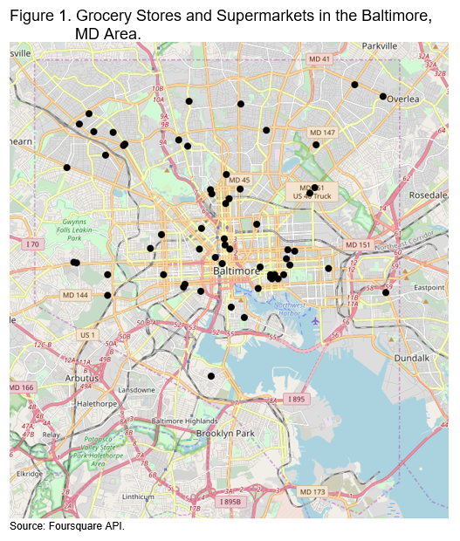
Results
The City of Baltimore, MD consists of more than 200 neighborhoods.
Using Foursquare, I searched for grocery stores and supermarkets in Baltimore that were within 300 meters of each neighborhoods center.
There was a total of 59 stores found and they are shown on the map on the right.
There are more stores closer to the city center, where there is likely a higher density of people.
The west side, the southwest, and the northeast parts of the city seem to lack stores.

Slide 12
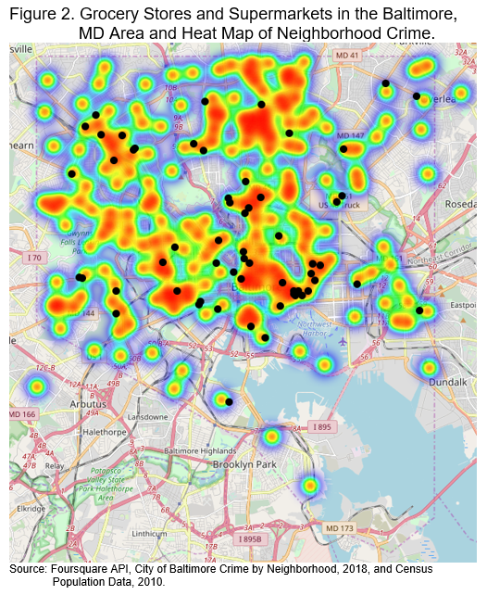
Results
The map to the right shows the grocery store and supermarket locations in Baltimore underlaid by a heat map of neighborhood crime.
While stores nearest the city center are located in both low and high crime areas, the farther one gets away from the city stores are more likely to be located in low crime areas.
High density urban areas are more likely to experience crime, yet stores are still likely to locate there. This could be due to the lower costs associated with operating in the city due to a greater presence of police. The outer edges of the city are likely to be less densely populated and the cost of doing business in a high crime area is higher.

Slide 13
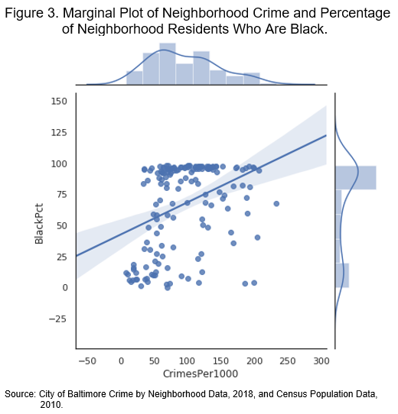
Results
As the previous slides showed, grocery stores and supermarkets are less likely to be located in high crime areas as one moves away from the city center. Who does this affect most?
We assume that greater neighborhood crime is associated with a larger percentage of Blacks in the neighborhood than other races. Such an assumption is supported by history.
Indeed, as the figure to the right shows, a high percentage of blacks in the neighborhood is associated with a higher neighborhood crime rate.
Blacks, then, are likely to be more impacted by the lack of grocery store and supermarket development in the city of Baltimore, MD.

Slide 14
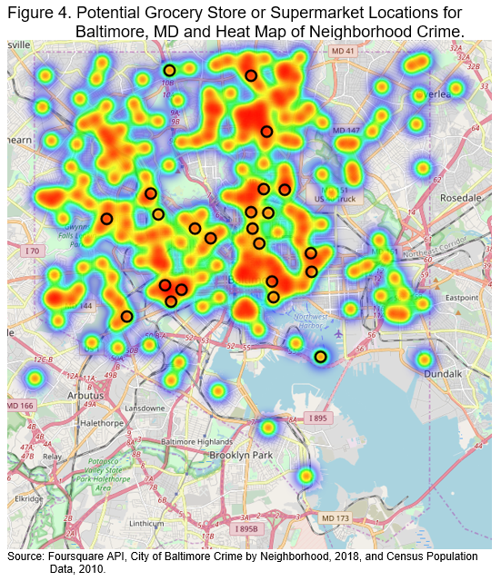
Results
We have already shown where existing stores are located. Now we turn to the task of highlighting neighborhoods where new stores might be potentially located.
Limiting our selection of neighborhoods to those with zero stores, but with high crime (above 150 per 1000 residents), we arrive at the following locations for new stores (see map on right).
A total of 23 neighborhoods met the conditions outlined above.
To the degree that crime is associated with percentage Black in the neighborhood, the city should anticipate that store placement in these areas will positively address concerns about Healthy Food Priority Areas in Baltimore.

Slide 15
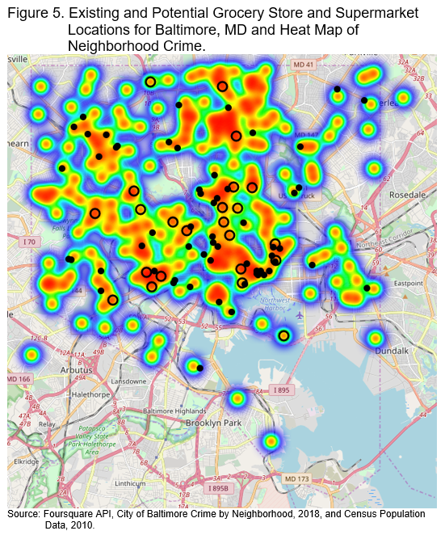
Results
First, however, let’s see how the city’s concentration of grocery stores and supermarkets might look if all the neighborhoods currently without stores added one.
The city already has 59 grocery stores and supermarkets, but if the city were to successfully work with chains to locate in the higher crime areas, the total number of stores would rise to 82.
Compared to Figure 1, Figure 5 shows a greater coverage of grocery stores in the city of Baltimore now, and they would likely be in neighborhoods that have high concentrations of Black residents who, according to what we already know, are already at a disadvantage when it comes to having access to healthy food.

Slide 16
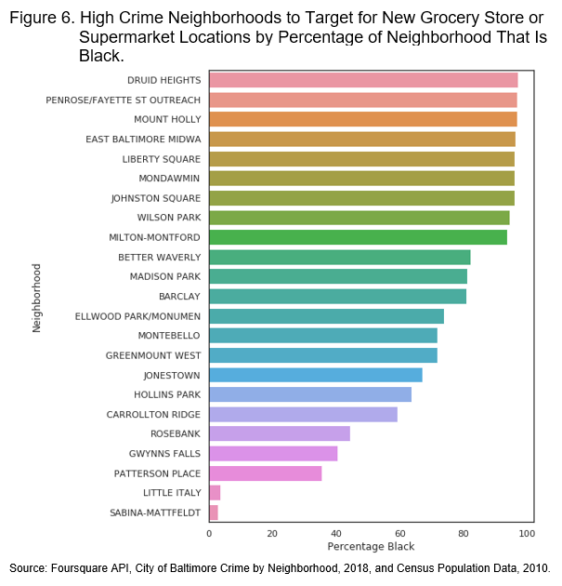
Results
Figure 6 to the right shows in descending order the percentage of Black residents by neighborhood, where the neighborhoods are those we identified as those having zero stores.
As we suspected, the majority (18 of 23) of the neighborhoods are majority Black. Indeed, more than half of these exceed 80 percent Black.

Slide 17
Conclusion
The aim of this study was to identify neighborhoods in Baltimore, MD that might be Healthy Food Priority Areas (i.e., food deserts). Because HFPAs are predominantly occupied by and affect the health and well-being of minority populations, such identification will help the city and potential investors work together to bring healthy food to the people who need it most. The study found:
There was a total of 59 grocery stores and supermarkets in the Baltimore, MD area.
Areas lacking a sufficient number of stores were the west, southwest, and northeast parts of the city.
High crime areas in neighborhoods with zero stores are candidates for potential stores locations in the future and their presence would provide greater grocery store and supermarket coverage for the city of Baltimore.

Slide 18
Limitations
Any study is only as good as the data used to carry it out, and I would have liked the best data for this study. Also, because the study involves policy and involves cooperation between public and private spheres, there are issues that are likely unknown. Some unknowns are known, but the unknown unknowns are the ones that can cause the greatest problems in the real world.
It would have been preferable to have official FBI crime statistics.
I would like to know whether the city of Baltimore plans to allay business’ concern about crime in new locations by allocating sufficient resources to police and protect private companies’ investment.

